Slide 1
9th International Conference on Informatics, Electronics & Vision Pathfinder: A Fog Assisted Vision-Based System for Optimal Path Selection of Service Robots
Paper ID:103
Niloy Irtisam
Riad Ahmed
Mohammad Moniruzzaman Akash
Raiyaan Abdullah
Sujan Sarker
Sejuti Rahman
Lafifa Jamal

Slide 2
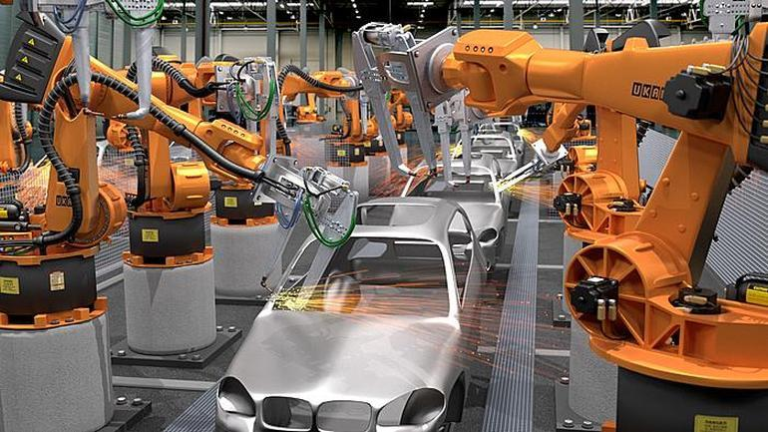
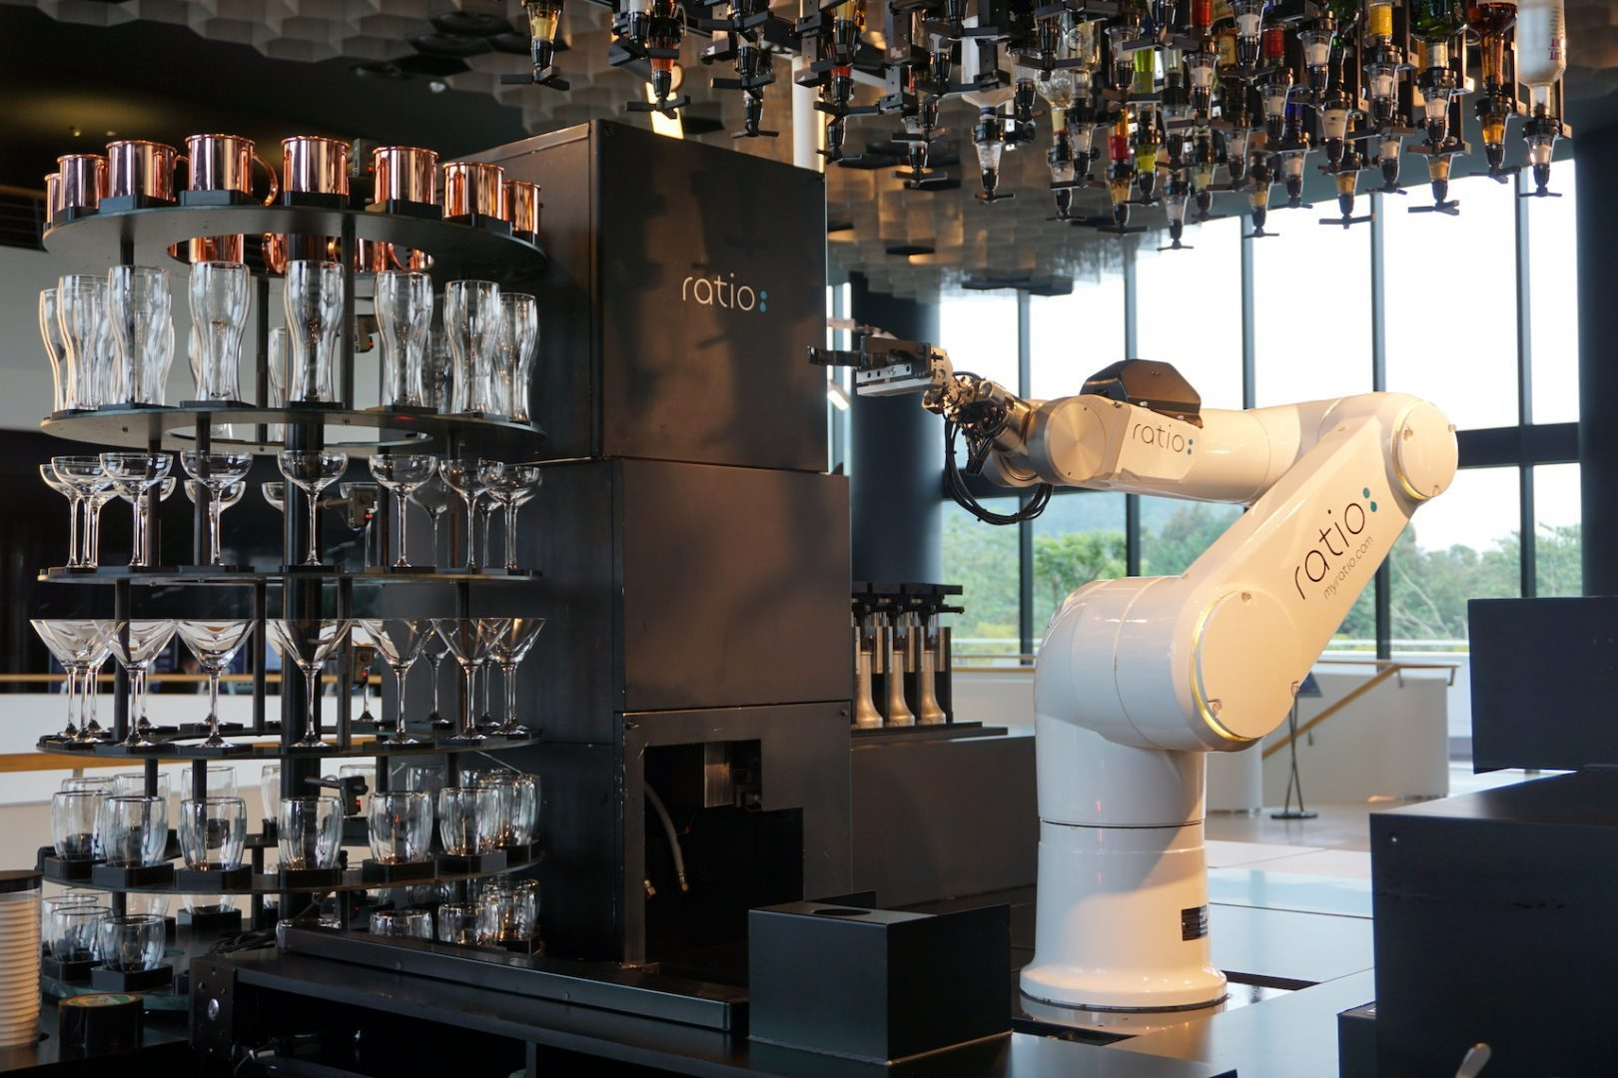
Introduction
Fig. 1: A car manufacturing assembly [1]
Fig. 2: A robot making coffee [2]

Slide 3
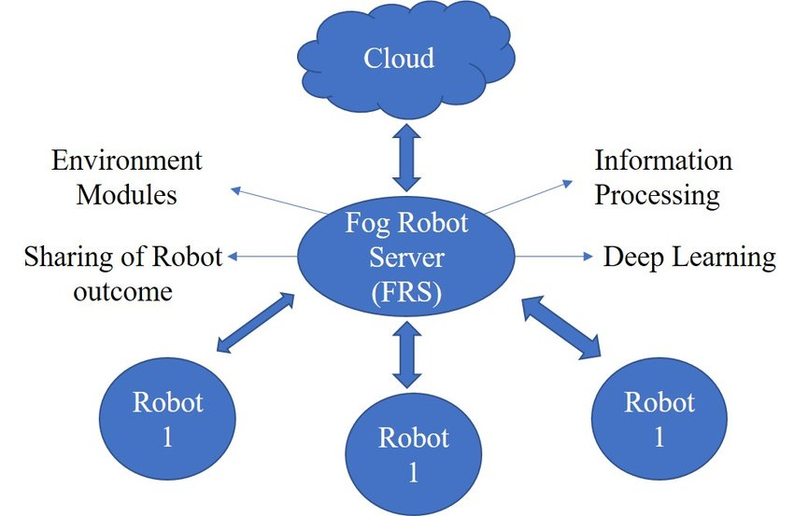
Fog Robotics
Fig. 3: Fog Robotics Architecture [3]

Slide 4
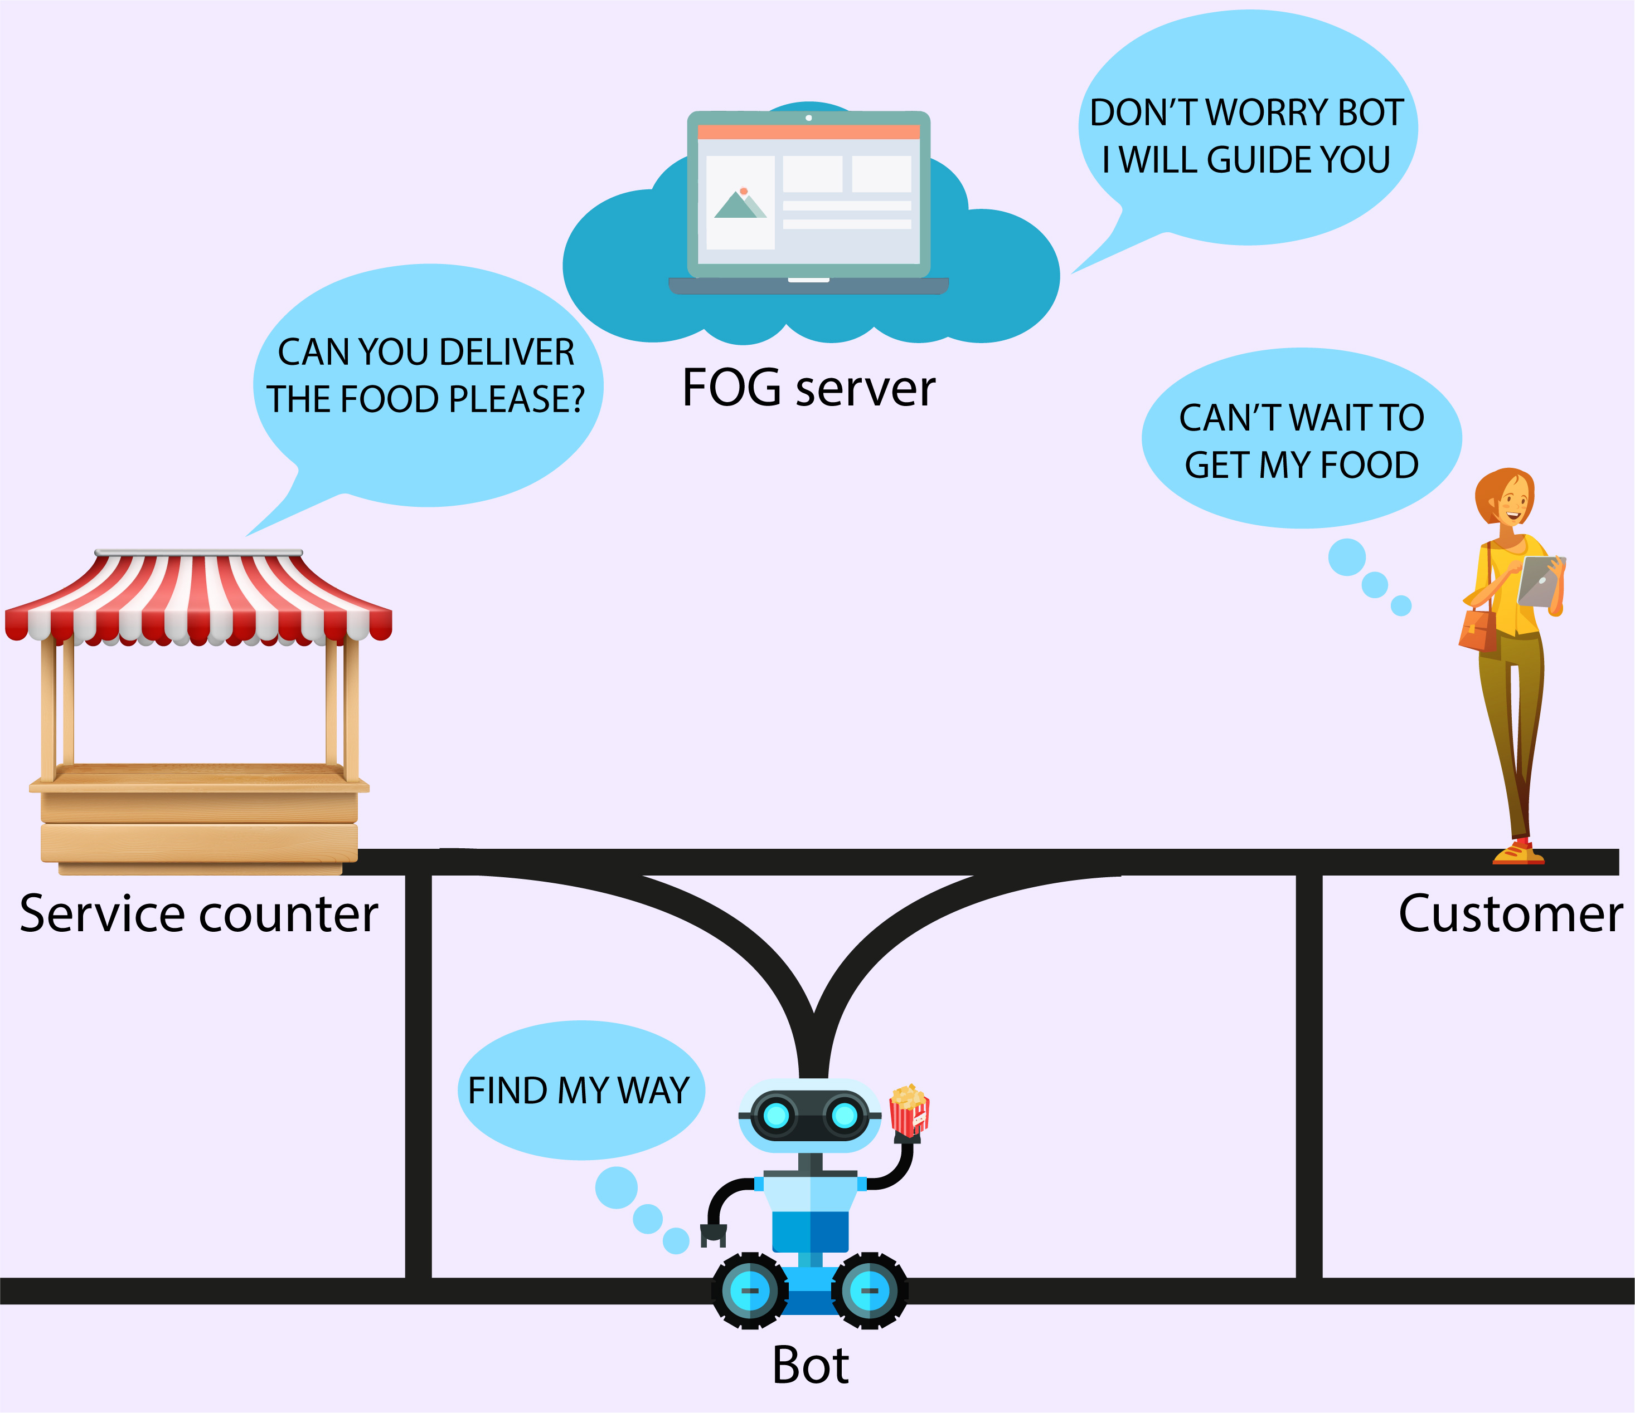
Proposed work
Fig. 4: Illustration of the Pathfinder system

Slide 5
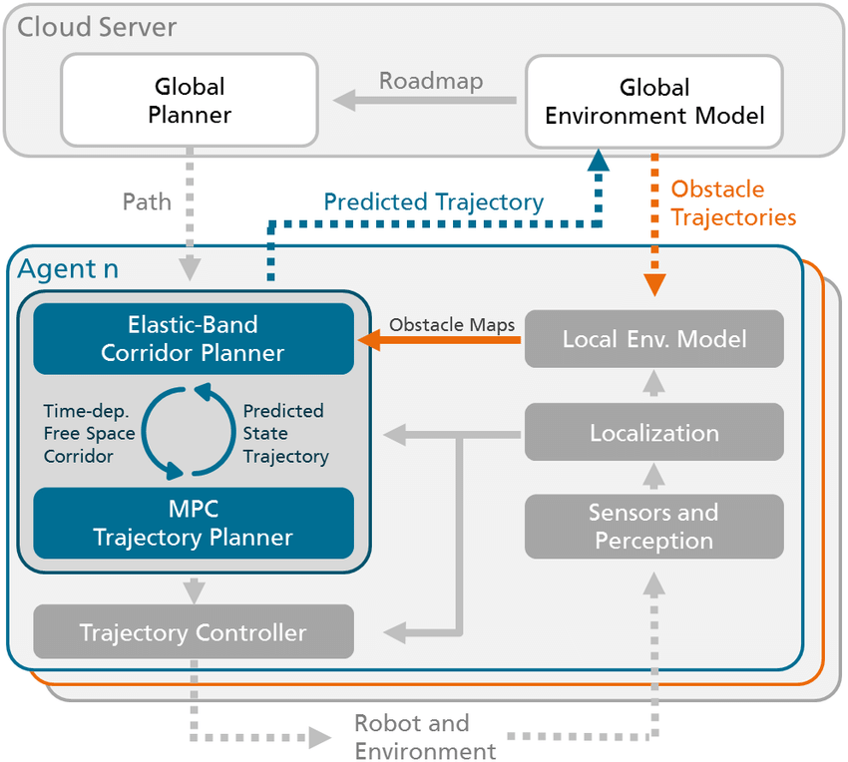
Related work
[4] F. G. Lopez, J. Abbenseth, C. Henkel, and S. Dörr, “A predictive online path planning and optimization approach for cooperative mobileservice robot navigation in industrial applications,” in 2017 European Conference on Mobile Robots (ECMR), Sep. 2017, pp. 1–6.
Fig. 5: System architecture

Slide 6
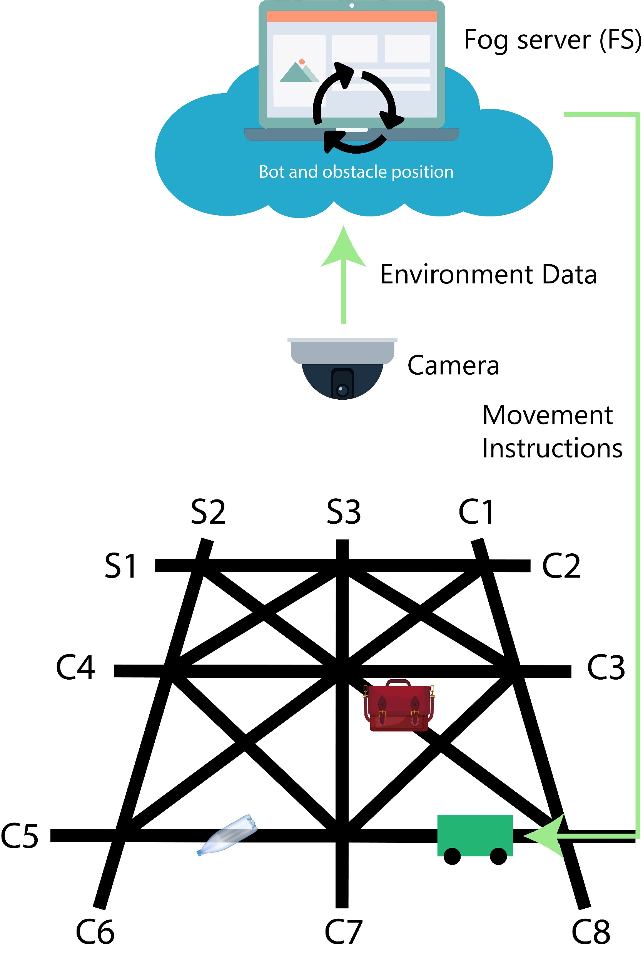
System Model
Entities:
A Fog server (FS)
Service robot (SR)
Customers (C1, C2, C3, ..., Cn)
Service points (S1, S2, S3, ..., Sm)
Fig. 6: Pathfinder System Model

Slide 7
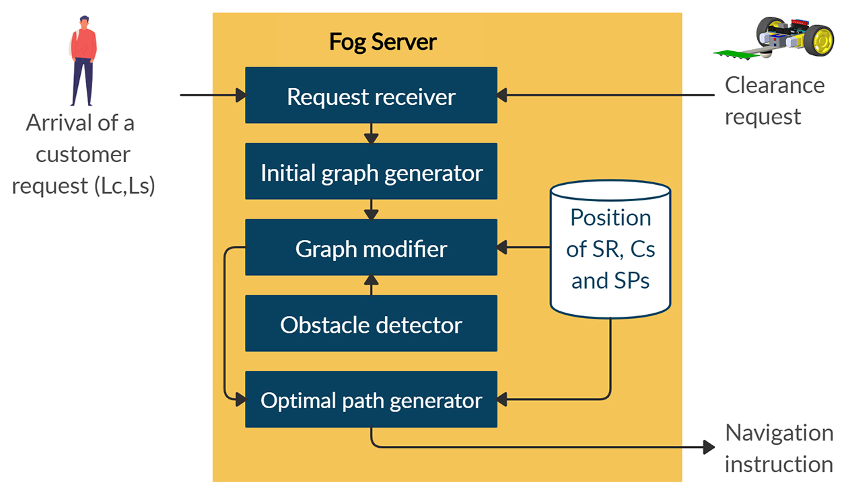
Workflow
Fig. 7: Workflow of the proposed system

Slide 8
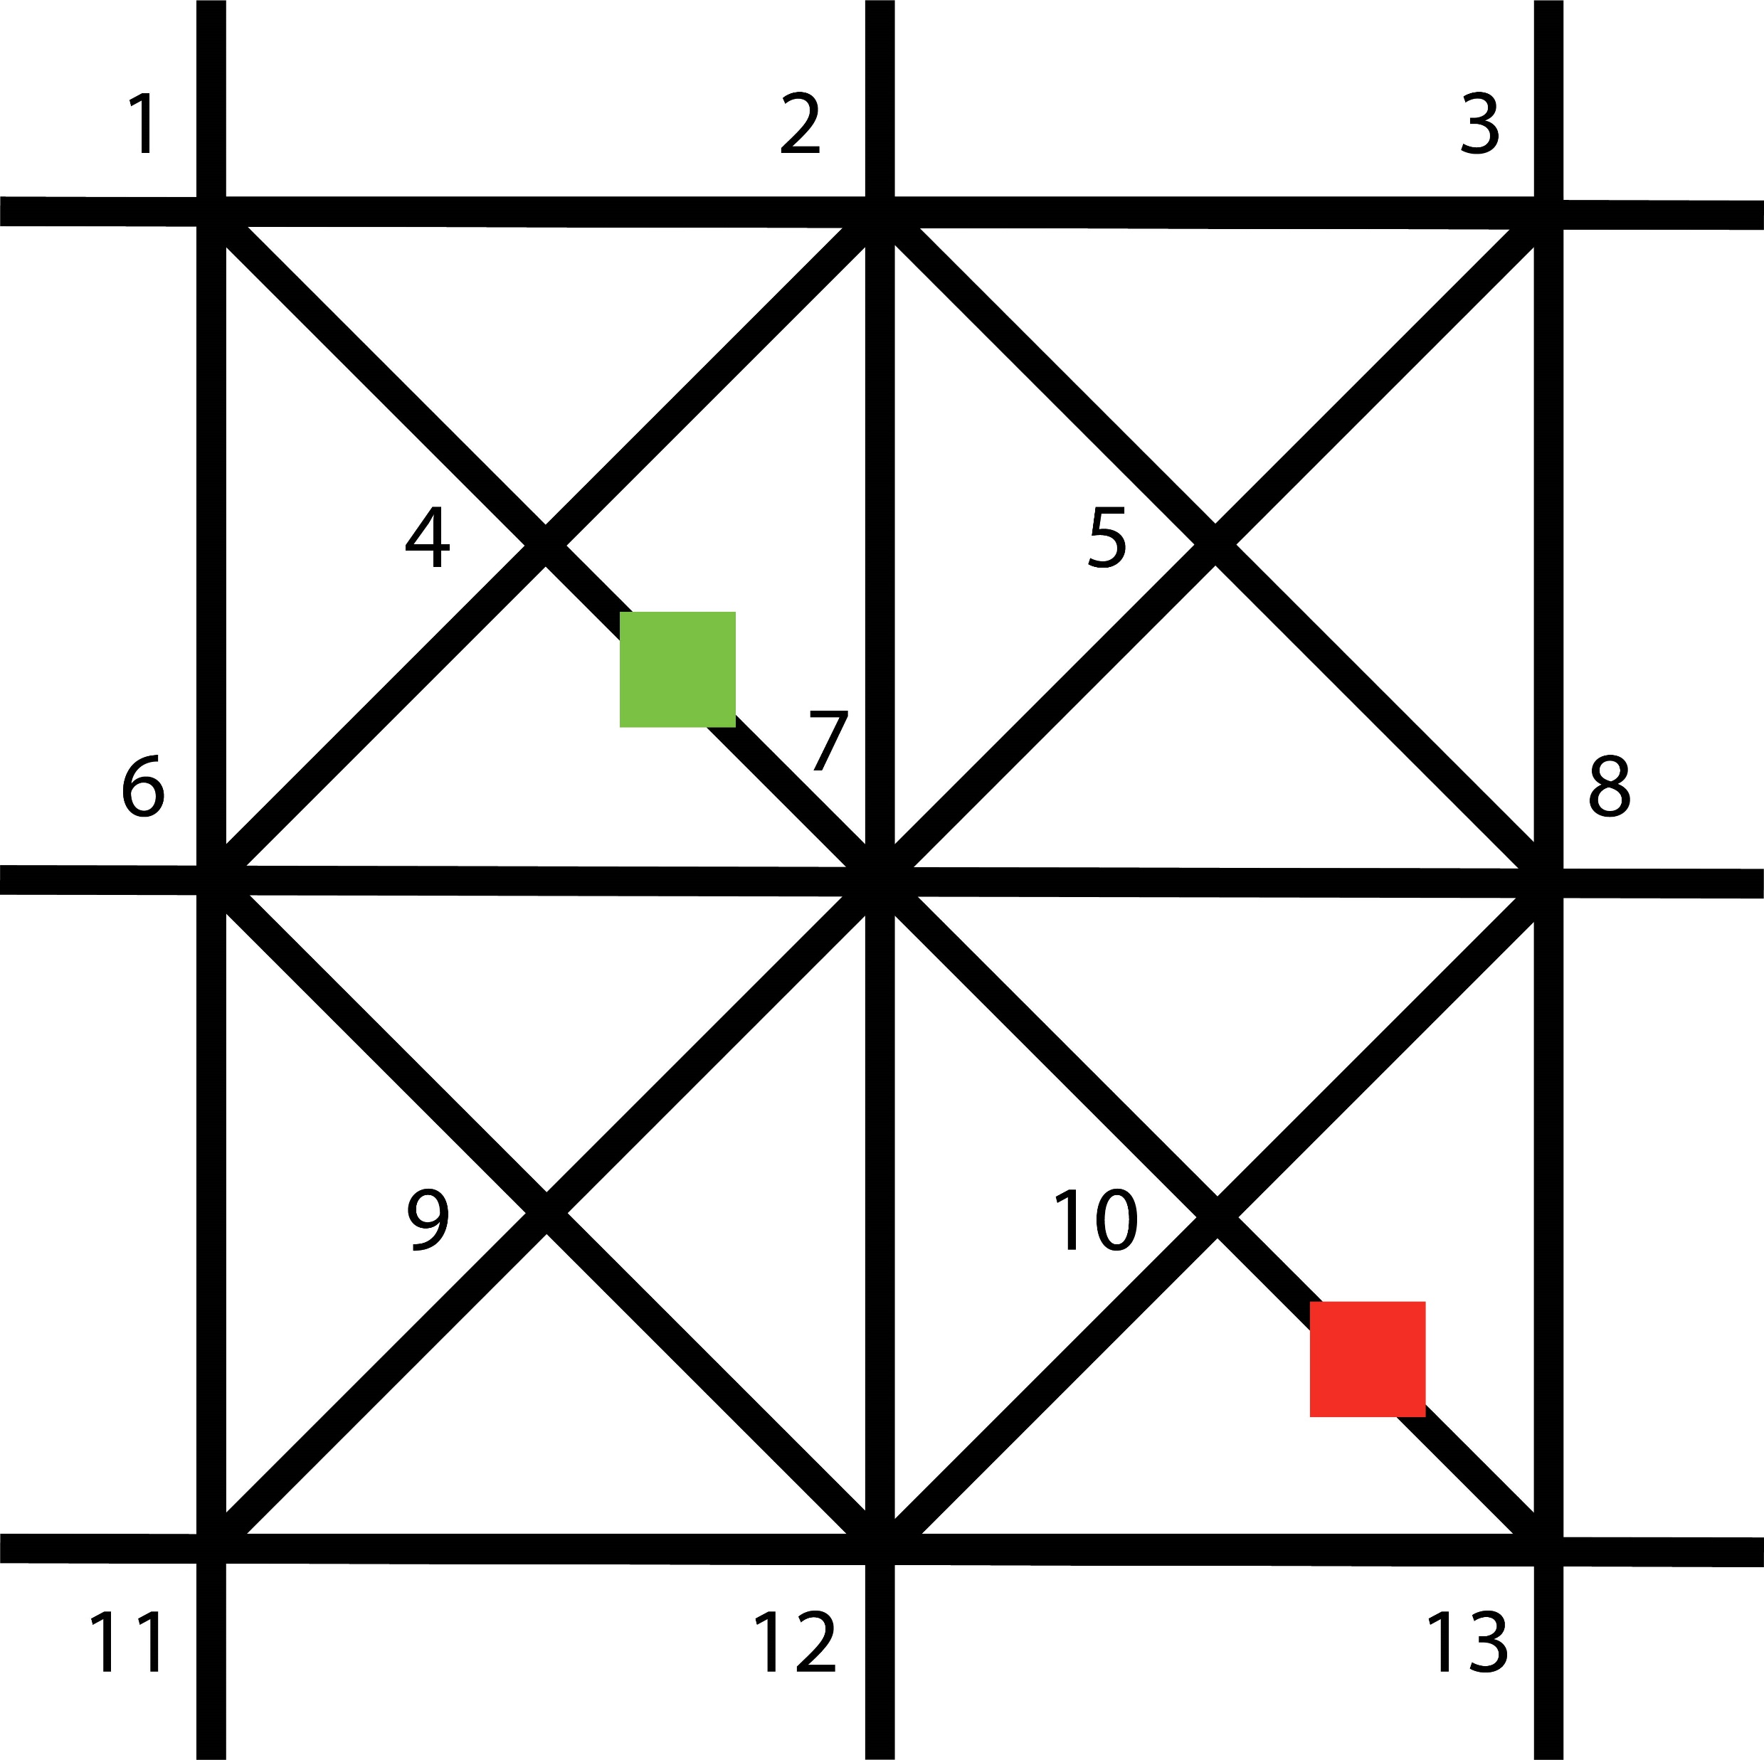
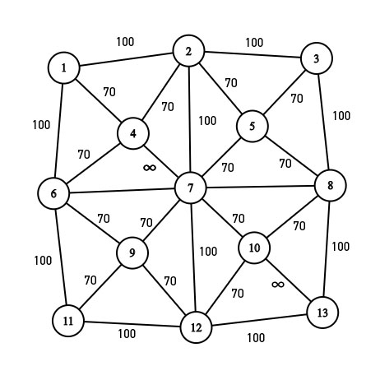
Graph generation and obstacle detection
Fig. 8: Generation of graph from environment image

Slide 9
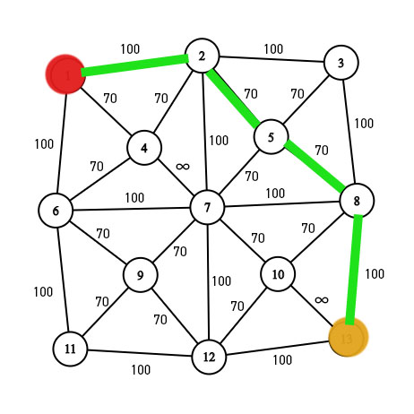
Optimal path selection
Two algorithms considered: Djikstra and Weight Convergence Accelerated A* (WCAA*)
Fig. 9: Generating optimal path from graph

Slide 10
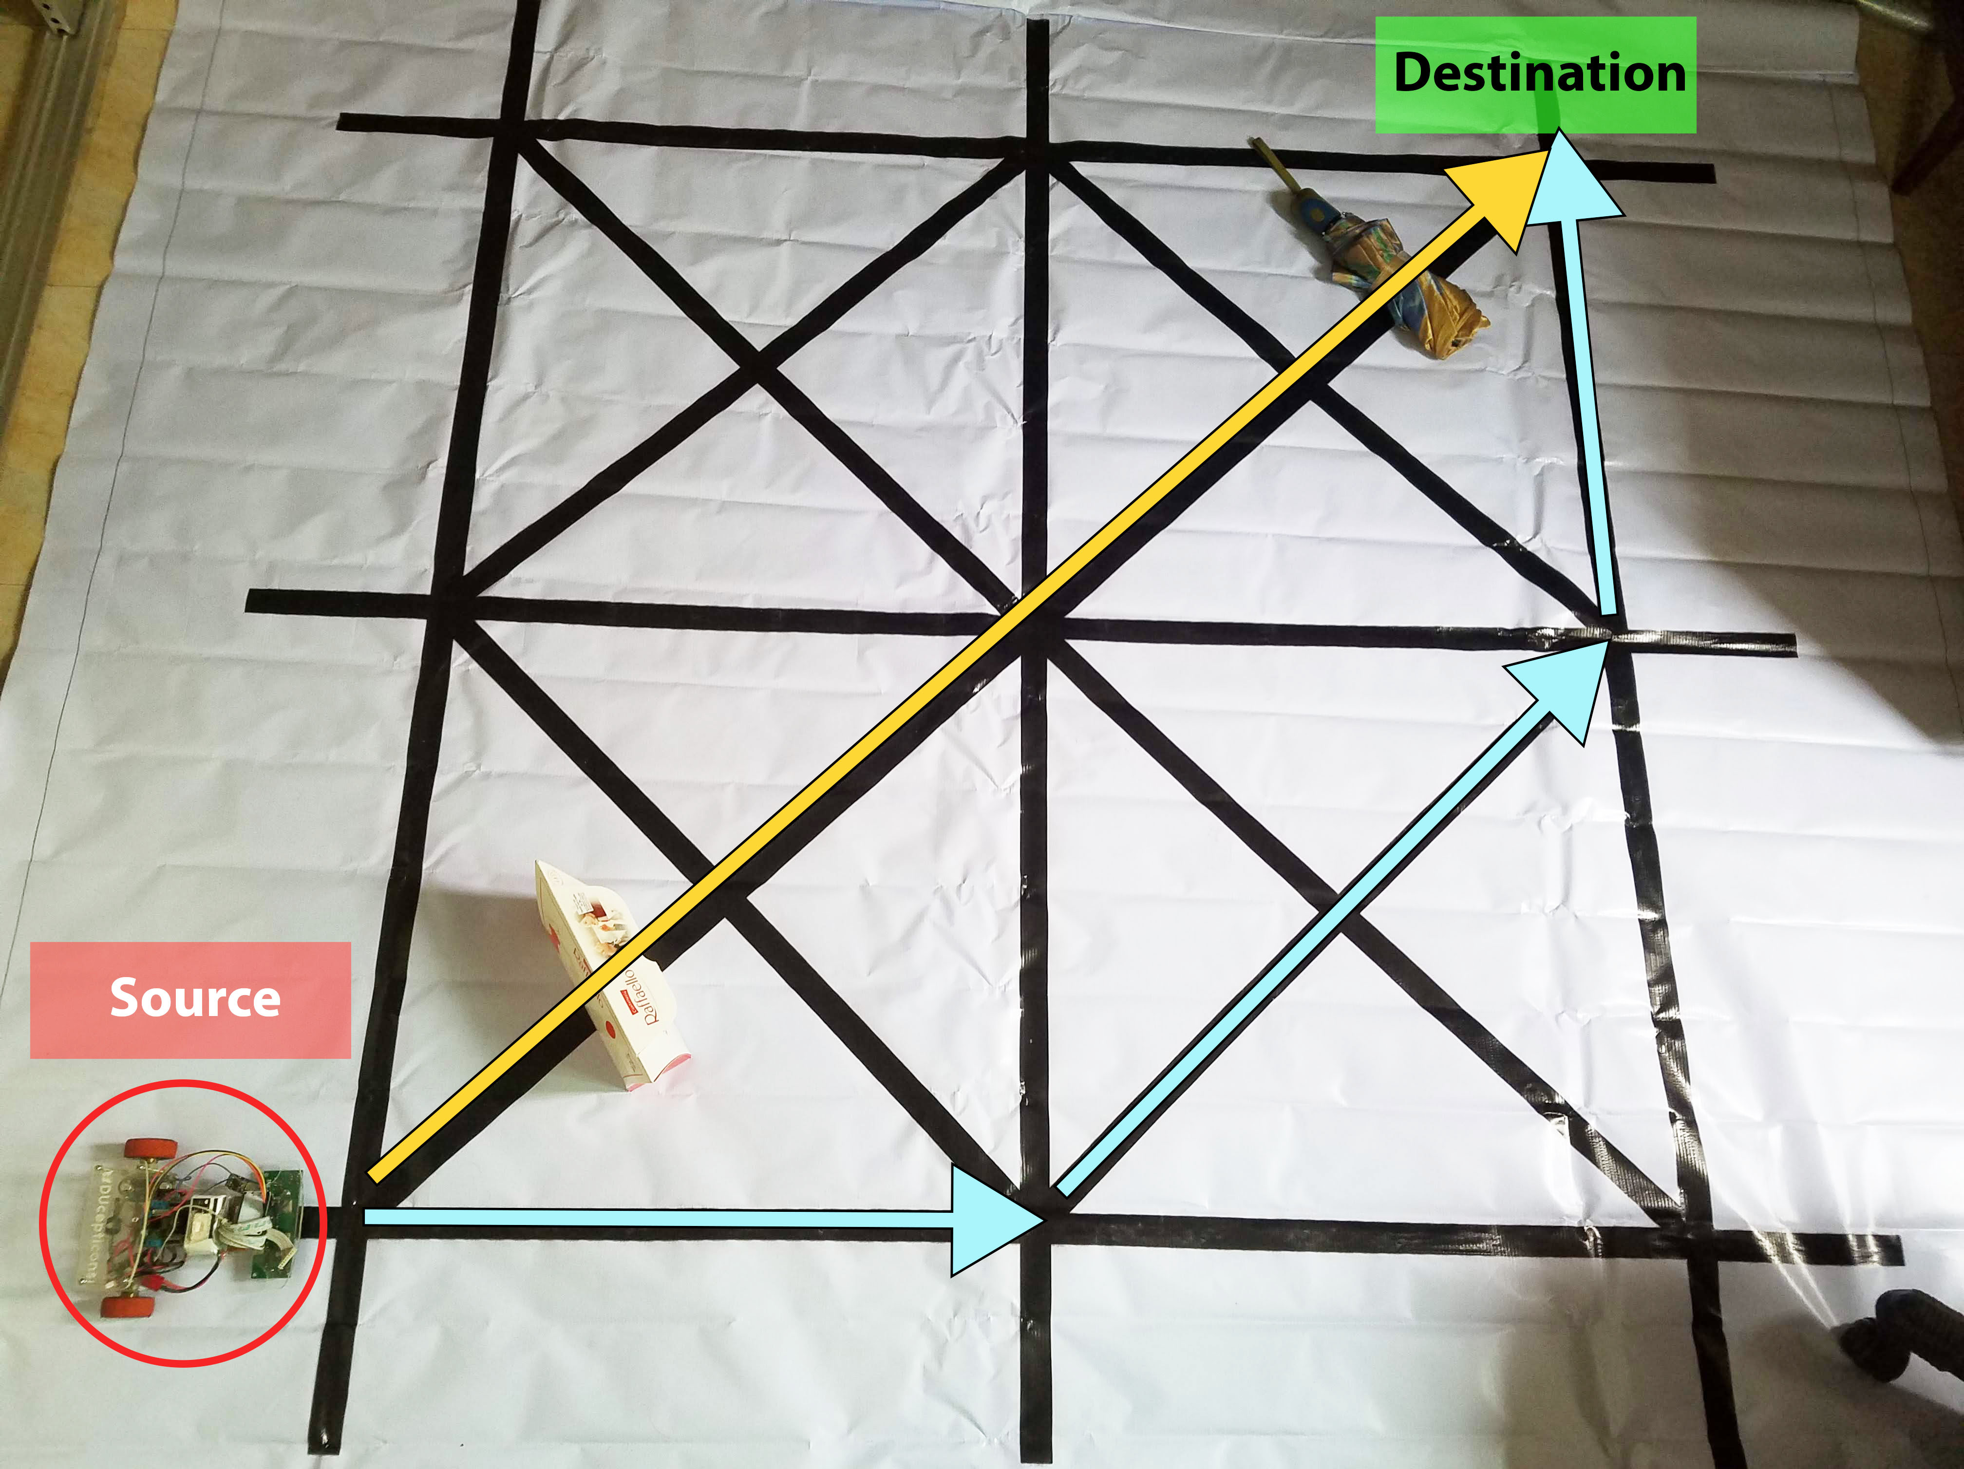
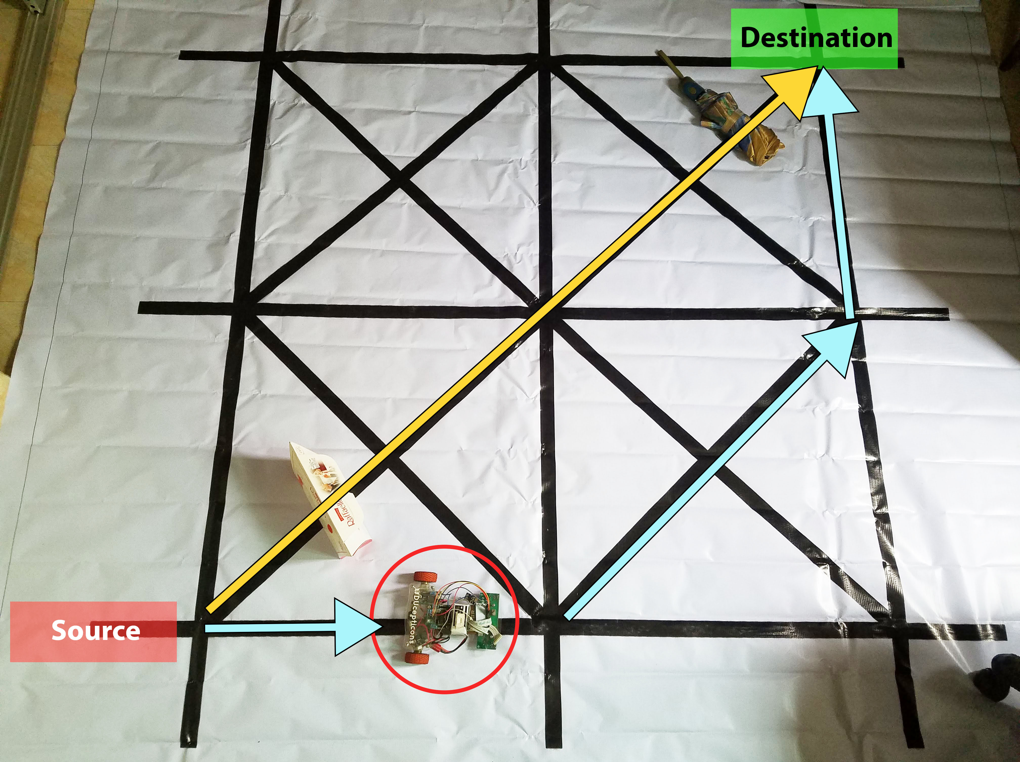
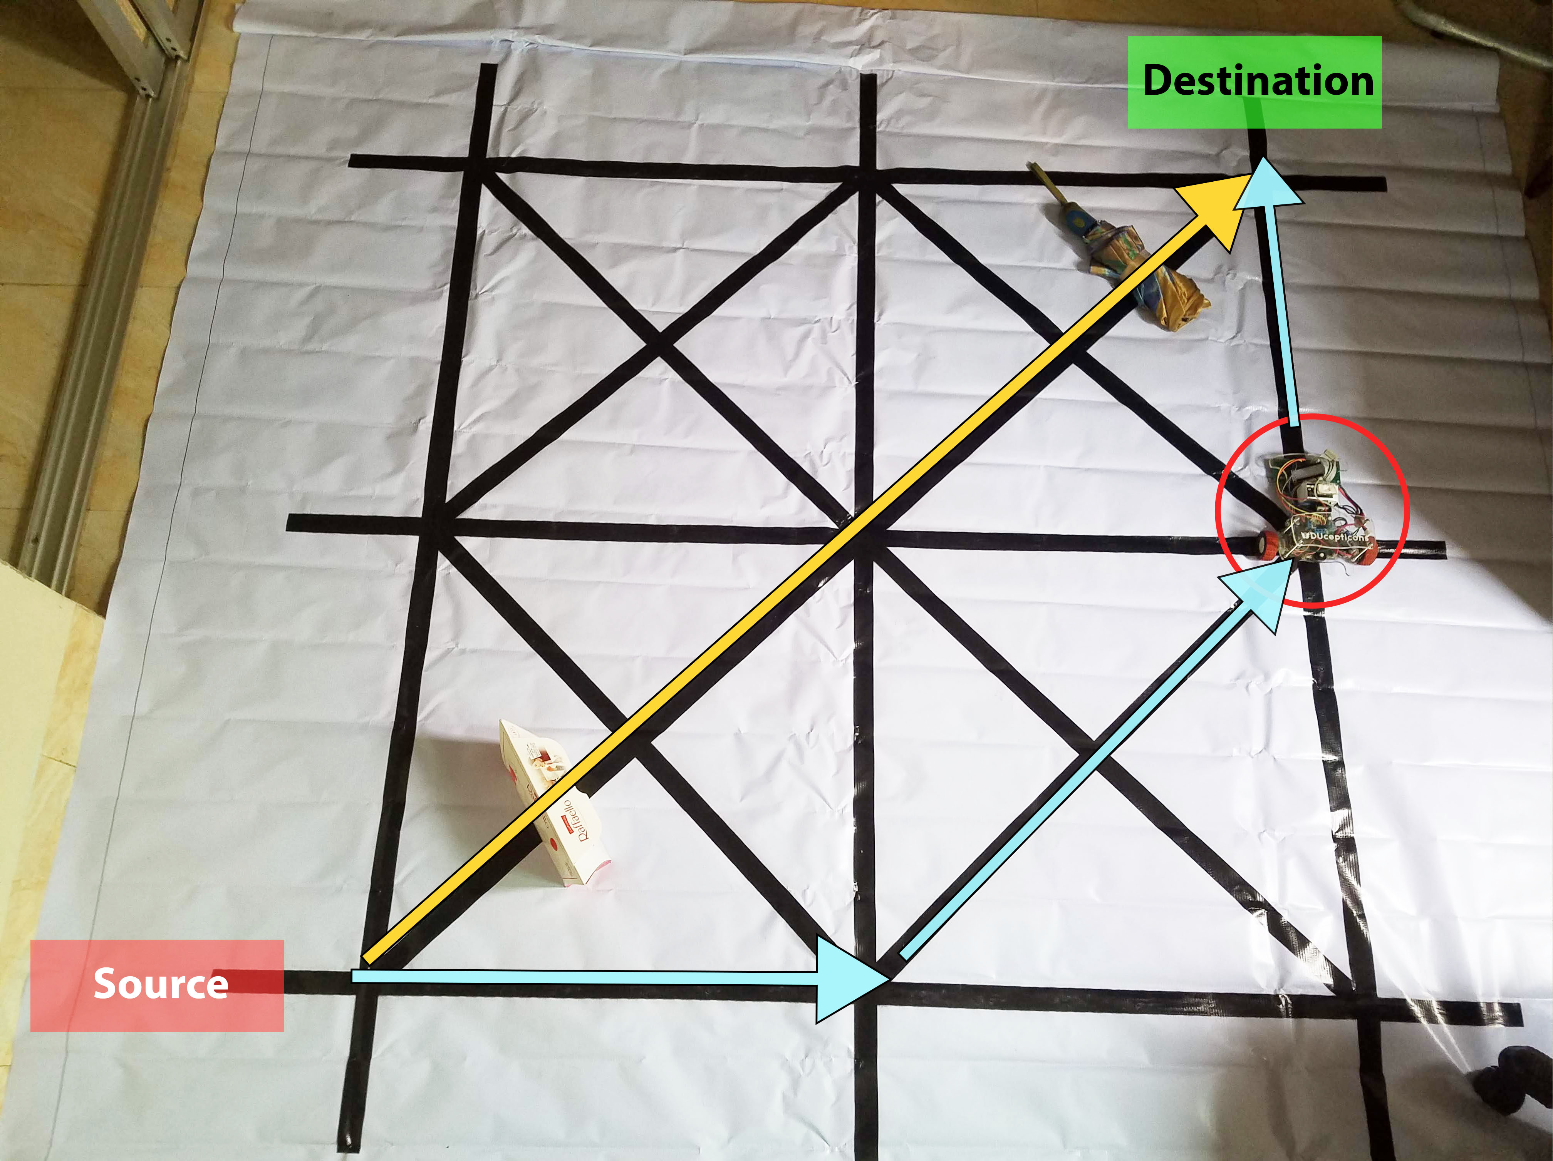
Simulation
Two comparisons made:
Fog vs no-fog system
Djikstra vs WCAA*
Fig. 10:Testbed simulation of the system

Slide 11
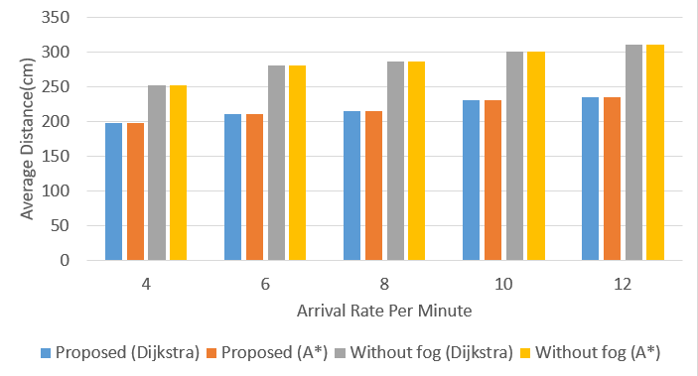
Performance evaluation
Fig. 11: Average distance travelled vs arrival rate graph

Slide 12
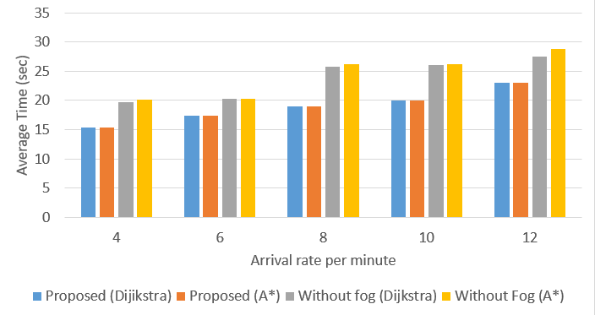
Performance evaluation (cont.)
Fig. 12: Average service time vs arrival rate graph

Slide 13
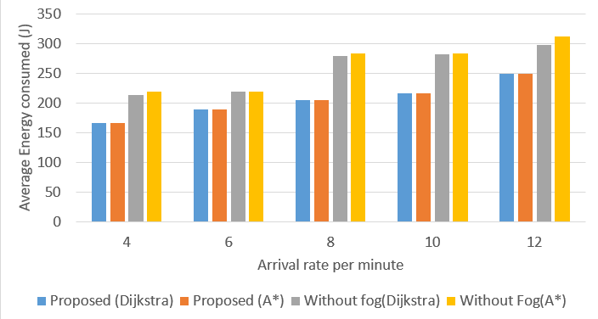
Performance evaluation (cont.)
Fig. 13: Average energy consumption vs arrival rate graph

Slide 14
Conclusion and future work
Vision based system for service robot navigation
Controlled by central Fog server
22% better performance compared to no-Fog system
Future work
Generate optimal path in environment without predefined track
Simulate multi robot environment
Simulate in a large environment

Slide 15
THANK YOU

Slide 16
QUESTIONS ?

